Slide 1
What’s it like to be a bat gamer?
Huw Talliss
Supervisor: Dr Paul Cairns
Notes:
What’s it like to be a bat gamer?
It’s an interesting title.

Slide 2

The effect of audio on immersion in games
Does audio have an effect on immersion?
Can an audio-only game be immersive?
Creating a game with multiple modalities to perform a study
  Audio-only
  Video-only
  Both
Notes:
It’s this kind of bat by the way, not a cricket bat.
This project looked into how audio effects immersion in games.
There’s been a lot of research into the concept of immersion, and a decent amount of research into how audio is used in games. But not much on how audio effects immersion.
The primary questions of this project were whether audio has an effect on immersion and whether an audio-only game can be immersive.
In order to answer these questions, a study was performed that involved creating a game with three modes of play (audio-only, video-only and both), modes.

Slide 3
What is immersion?
Being absorbed in a video game
Important part of what players seek from games
Three levels¹:
  Engagement – invest time to play
  Engrossment – dedicate a lot of attention
  Total Immersion – completely involved
Immersive Experience Questionnaire (IEQ)²
  Breaks down to 5 constituent factors
Notes:
Let’s start with taking about what immersion is.
Most people that play video games can remember a time when they were so invested in a game that they forgot about the outside world, they feel like they’re “in the game”.
This is quite a common experience, and is seen as desirable by both players and game developers, it is a feeling that many players seek from games
Brown and Cairns found three distinct levels of immersion,
-Engagement where players simply invest the time necessary to play
-Engrossment where players dedicate a lot of attention to playing
-total immersion where players are completely involved to the exclusion of everything else, usually a transient feeling
An hard part of immersion research is measuring immersion as it’s subjective experience.
Jennett et al. created the immersive experience questionnaire to allow us to measure immersion, it consists of 31 Likert scale questions about the experience players had when playing.
From the IEQ we get a metric for total immersion, which can then be broken down into five constituent factors:
-Challenge
-Control
-Emotional Involvement
-Cognitive Involvement
-Real World Dissociation
The IEQ was used in the study performed in this project.

Slide 4

Audio in Games
Most games use it to enhance the player experience
Some games use it as a core element of the game experience
  As an important modality – key channel of communication
Three categories:
  Rhythm
  Pitch
  Spatiality
Notes:
The other part of the project topic is game audio
Audio has been used in video games more or less from the start, though initially extremely limited by early technology.
Nowadays most games use audio in order to enhance the player experience that the game provides.
For some games however, audio is much more than decorative, it is an integral part of the game experience, it acts as an important modality – a key channel of communication with the player.
Through looking at many examples of these games, I defined three major categories of game based on the aspect of audio that was important in them:
- Rhythm
- Pitch
- Spatiality

Slide 5
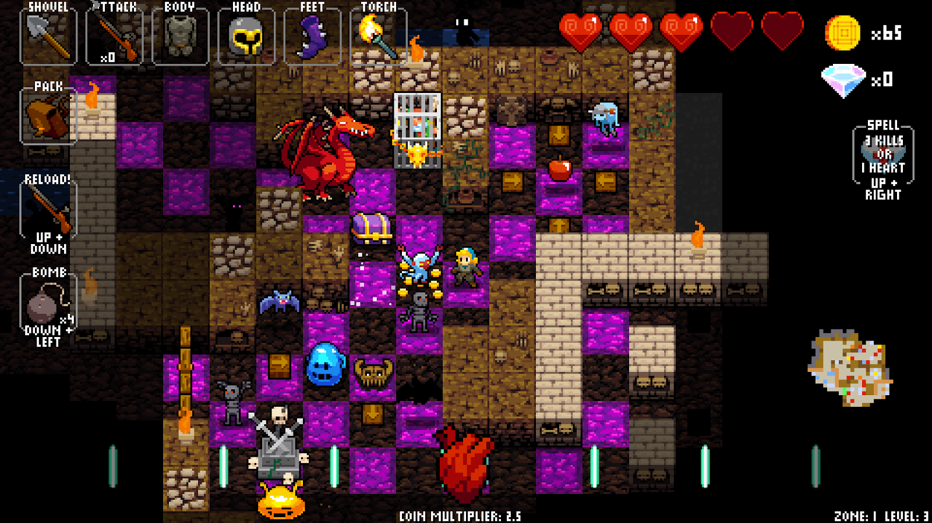
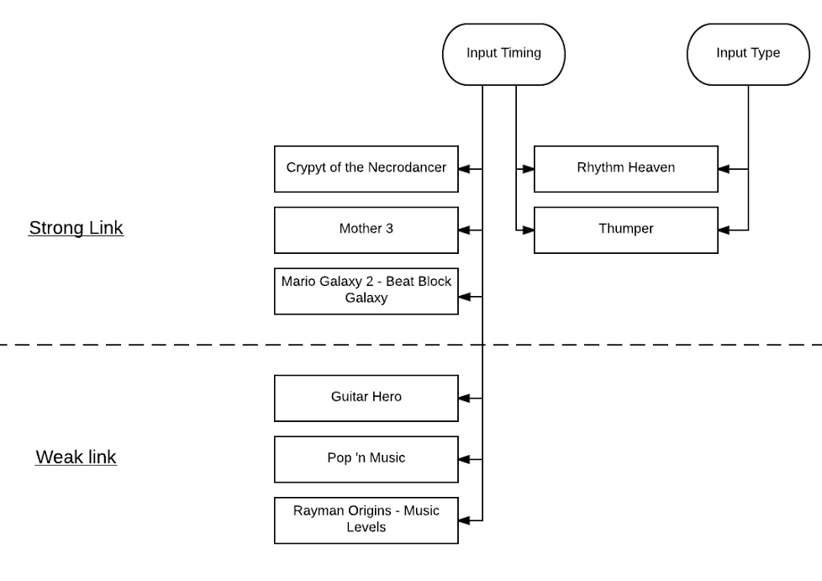
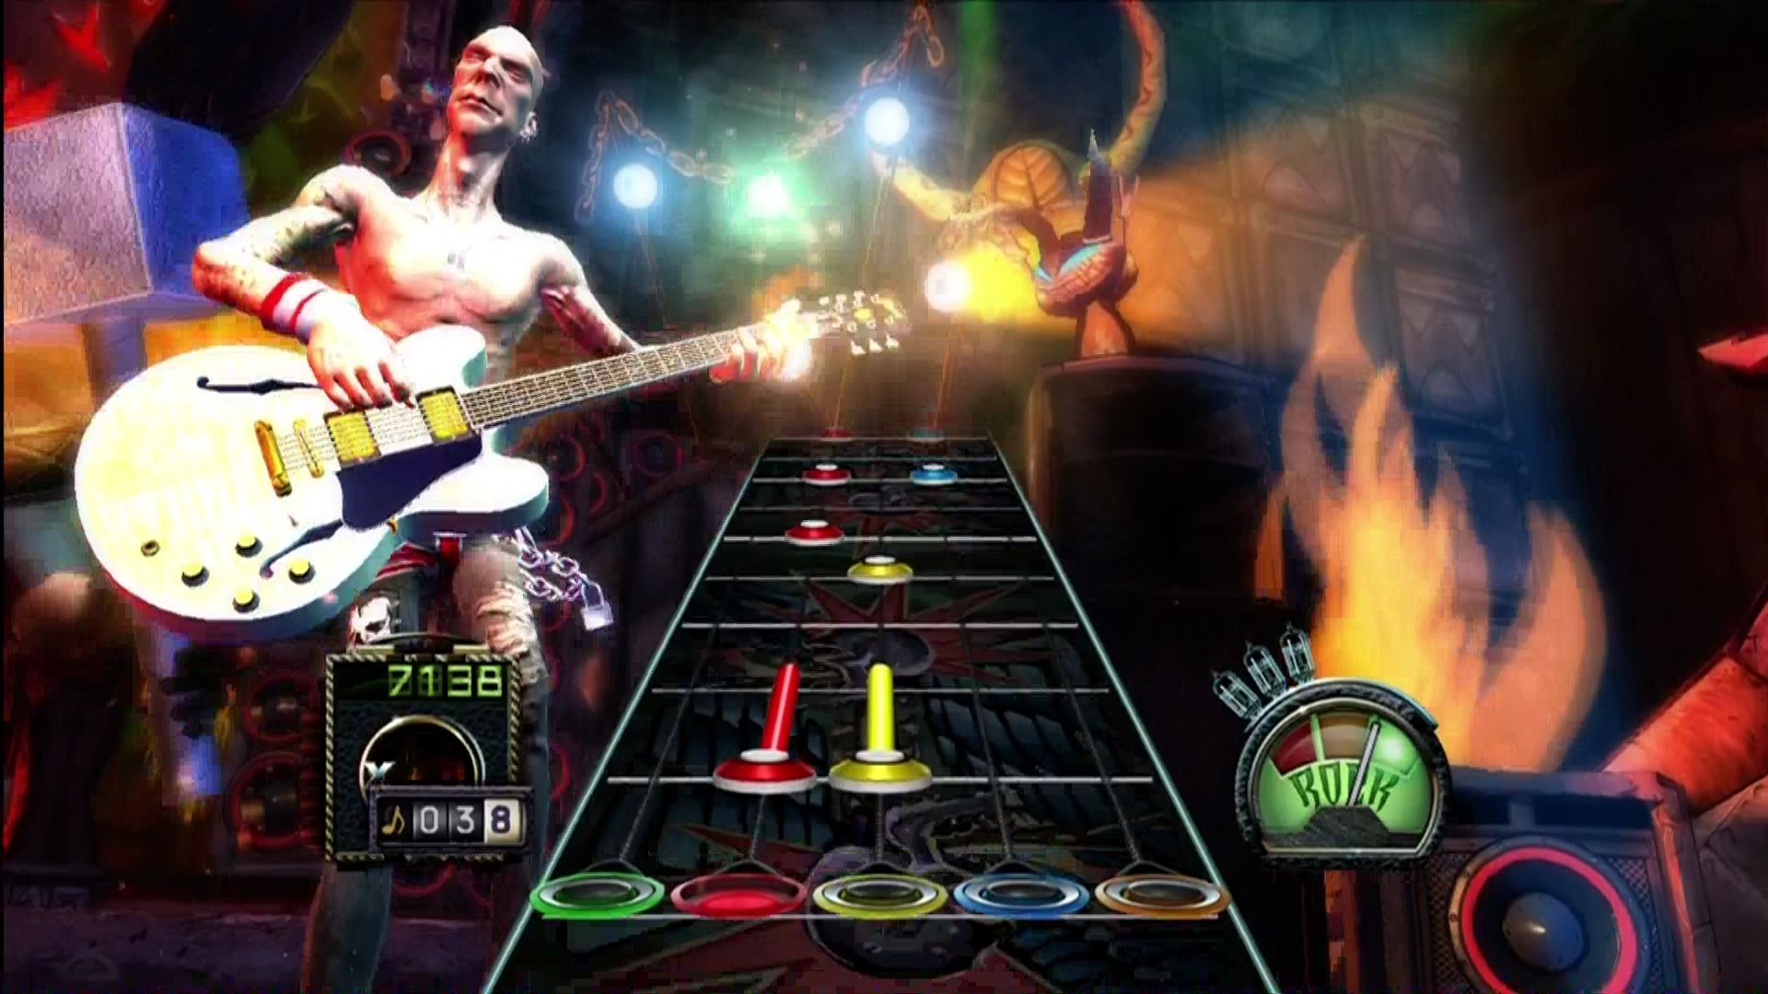
Rhythm Classifications
Crypt of the NecroDancer, 2015
Guitar Hero, 2005
Notes:
I created a diagram to help classify rhythm games.
In terms of player input, most rhythm games use audio to dictate the timing of the input the player must give (e.g. they must press a button on-beat). However some rhythm games also dictate the input type as well (e.g. player must press button ‘A’ when they hear a certain rhythm, and button ‘B’ when they hear a different rhythm).
In some games, there is a strong link between rhythm and the required player input. In Crypt of the NecroDancer, player inputs must always be entered in-time with the beat of the music – there is a strong link between the audio and the input.
Other games like guitar hero have a weaker link, with the visual position of notes being more important to the input timing than the rhythm and sound of the music playing.

Slide 6
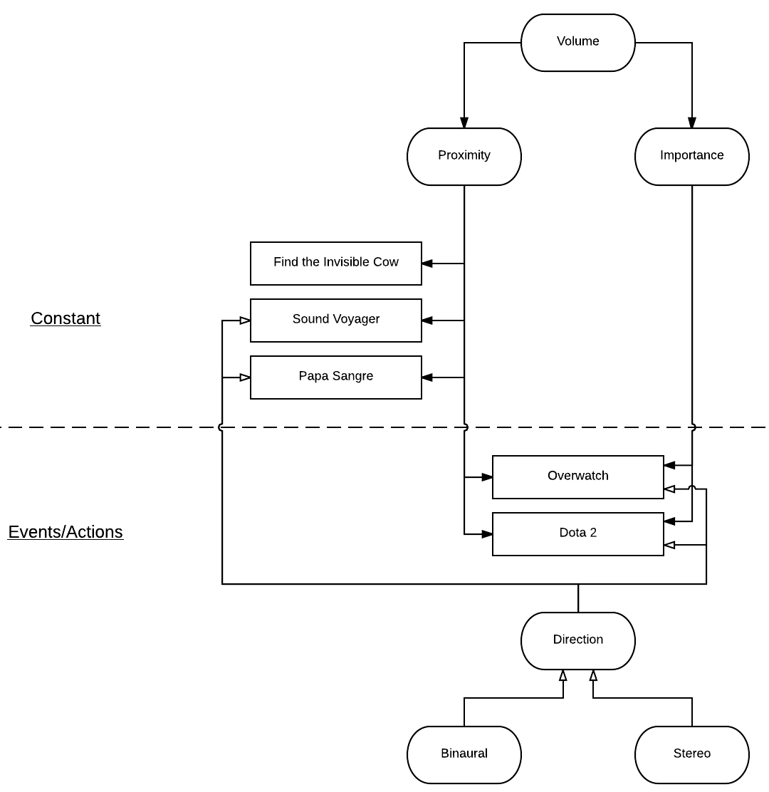
Spatiality
Notes:
I also created a similar diagram to show how games use spatialised audio as an important modality. Spatialised audio is audio that has been processed (using stereo panning and volume adjustment etc.) to give its source a spatial location in the game environment, e.g. in a 3D space.
This diagram breaks down games where spatiality is an important modality based on their use of volume (some games use it for proximity, others for importance of sound), and use of directional audio.
Another aspect of the diagram are the two types of sounds, constant vs events/actions.
Some games use sound which is constant/continuous, which are used to give an auditory reference point to the player when navigating the world, this is used particularly in audio-only games like Papa Sangre.
More commonly is that games sounds are caused by events/actions taking place in the game, and this is also represented on the diagram.

Slide 7
The Game
Made a simple rhythm game
Has three modes of play:
  Audio-only
  Video-only
  Both
Important that modes had equivalent gameplay
Needed a short, comprehensive tutorial
Notes:
In order to perform a study to answer the questions posed by this project, a rhythm-game was created.
The concept was balls bounce towards a paddle in-time with music, and the player must press a key at the right time to hit the balls with the paddle.
It has three modes of play and it was very important that the three modes were comparable to each other in gameplay, to avoid confounding our results.
When played, the game would record logs on the performance of the player, logging how many and which balls they correctly hit.
It was also necessary for the game to have a short but comprehensive tutorial so participants could quickly learn how to play the game, so the be able to play effectively on their first time.

Slide 8

Notes:
Here’s a short video of the gameplay in the ‘both’ mode. There are three different types of ball that enter from the left in-time with the music.
The player must press the spacebar to cause the paddle to hit the balls.

Slide 9
The Study
Hypothesis:
  Audio has an effect on immersion
  Players can become immersed in an audio-only game
45 Participants – 15 per condition
Procedure
  Demographic Survey
  Play the Game
  Immersive Experience Questionnaire
Notes:
So this game as the testbed of the study.
The hypothesis for the study was that audio does have an effect on immersion in video games. And also that players can become immersed in a game when deprived of a visual interface (i.e. in an audio-only game)
45 participants were gathered using opportunity sampling for this between-participants study, with 15 per condition (audio-only condition, video-only condition, and the both audio and video condition)
The procedure of the study went thusly:
Firstly participants answered a demographic survey including questions on their prior rhythm game experience and prior musical experience.
Then they played the game, first playing the tutorial and then the game itself
Finally they answered the immersive experience questionnaire in terms of their experience playing

Slide 10
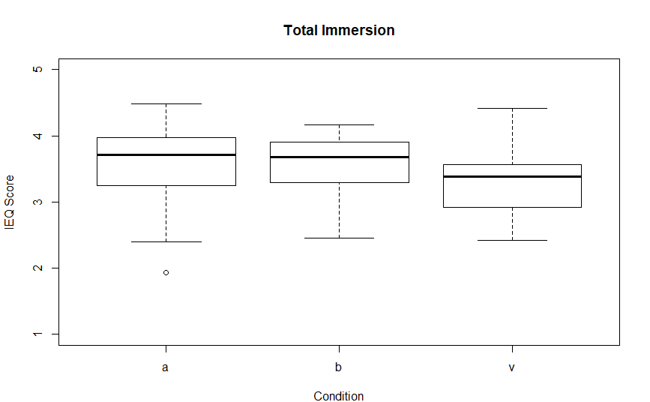
Results
Notes:
From the IEQ we get scores for total immersion between the conditions (audio-only, both and video-only from left to right on these box plots)
There is a clear trend towards more immersion in the audio conditions but the difference is not statistically significance.
Breaking the total immersion score into it’s constituent factors we find some interesting results.

Slide 11
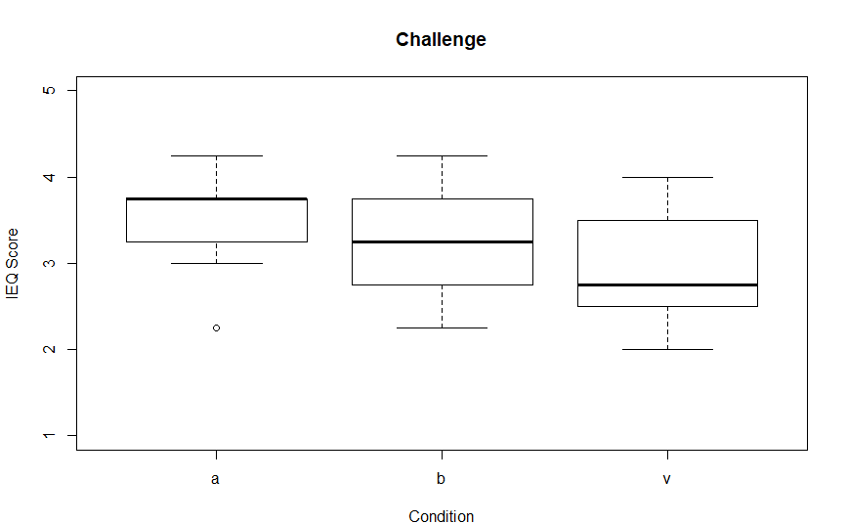
Challenge
Notes:
The challenge factor was statistically significant, with players finding the modes that utilised audio more challenging than the video-only mode.
A higher amount of challenge likely increased the immersion players experienced and likely caused the results we see for the…

Slide 12
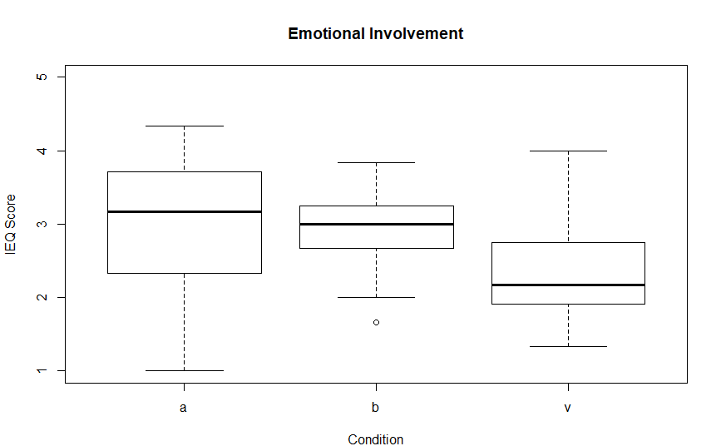
Emotional Involvement
Notes:
Emotional involvement factor.
Emotional involvement was marginally statistically significant and was likely higher in audio modes due to the increased perceived challenge in those modes.

Slide 13
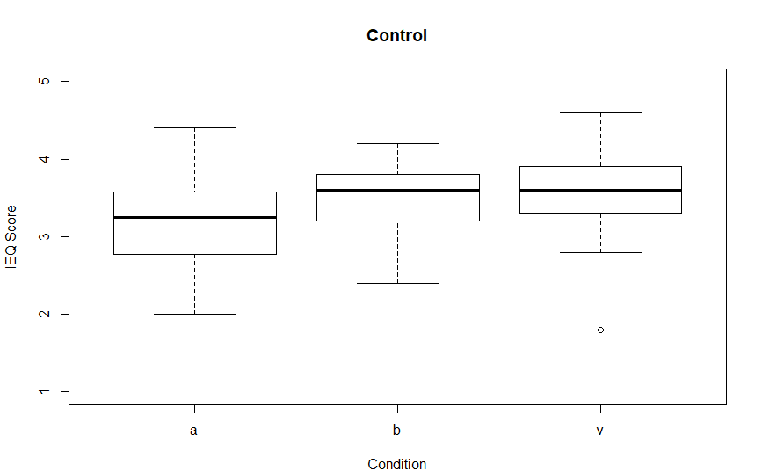
Control
Notes:
The control factor was noteworthy in it acting opposite to the other factors. Control was perceived as worse in the audio-only condition than the others which likely caused the increase in perceived challenge in the audio-based conditions.
It may also be that the reason total immersion was not statistically significant was due to this control factor working opposite to the others.

Slide 14
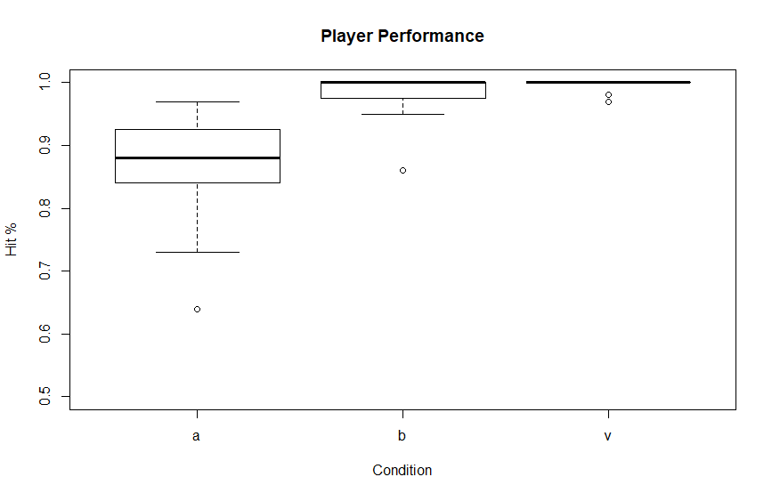
Player Performance
Notes:
Another interesting result was player performance which was gathered from the game logs which were recorded for each player.
Players of the modes with audio performed worse than the video-only mode, with audio-only considerably worse.
There was a statically significant difference between these scores (p<0.001).
These results are partially explained by the control scores and also correspond with the scores for challenge. It also points towards a possible effect on player performance between audio and video interfaces, which may merit further research.

Slide 15
Summary
Audio has an effect on immersion
Audio-only games can be immersive
Further work on the extent of the effect
Notes:
From these results and in view of our hypotheses we can say that audio does seem to have an effect on immersion, indeed it slightly increases immersion over a video-only experience, based on the results from this study.
We can also see that audio-only games can indeed be immersive. Indeed, excluding the control factor, the audio-only mode was consistently equivalent to or better than the ‘both’ mode for all aspects of immersion.
Further work could be performed to better understand the extent of the effect of audio on immersion, as this study was primarily exploratory just to see if there was an effect at all. So there is good scope for further work in this area.

Slide 16
Thank you

